Slide 1
Kittitas County Voluntary Stewardship Program
Watershed Group Meeting
October 25, 2019 10AM to Noon
Armory, Kittitas Valley Event Center

Slide 2
Review Minutes
Minutes – July 26, 2019

Slide 3
Watershed Group Membership
Washington Water Trust
Trout Unlimited
Technical Subcommittee

Slide 4
Outreach Activities
On-Line Map and Inventory

Slide 5
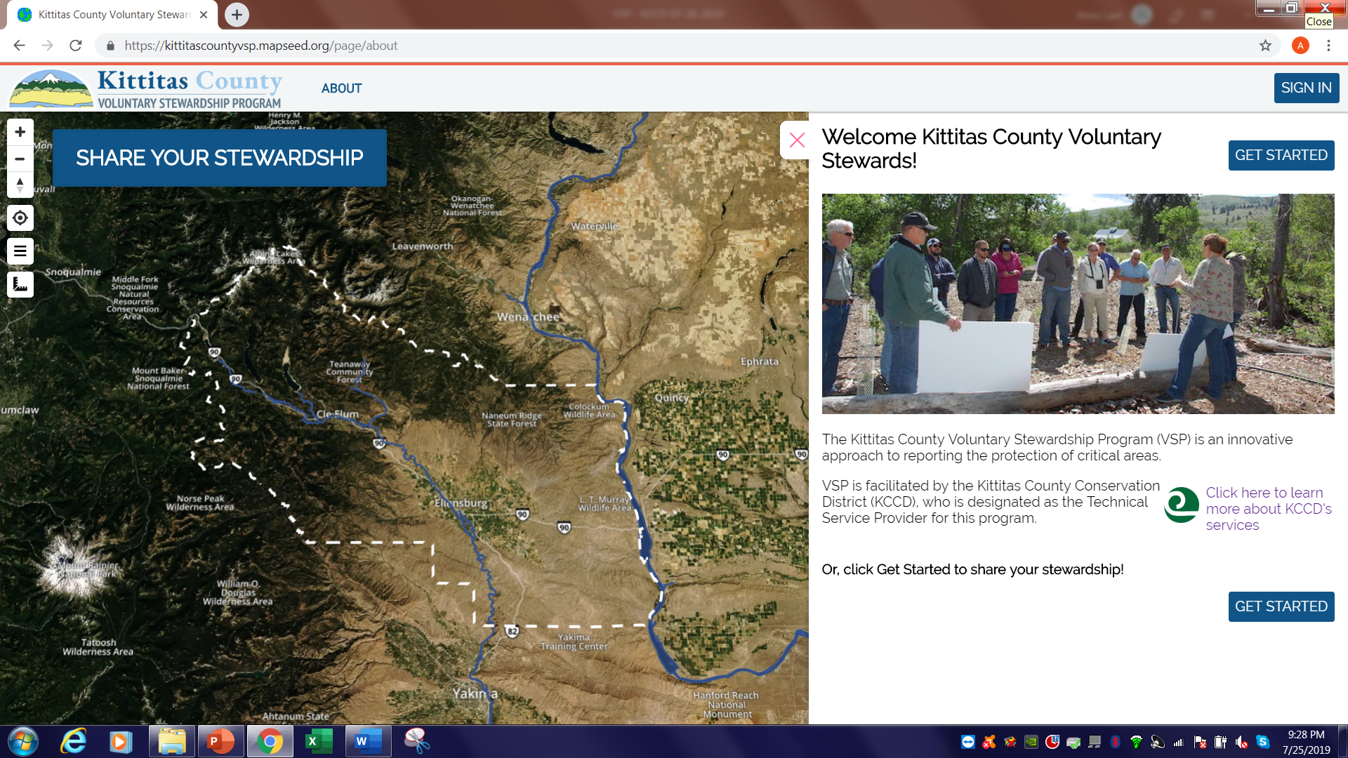
Outreach Activities
On-Line Map and Inventory Project”

Slide 6
Outreach Activities
Outreach plan status
Release of map and survey
Newsletter
Social Media
Website
Workshop – Soil Health February 2020

Slide 7
Technical Assistance
Landowner Inventories
Drone Technology

Slide 11
Financial Assistance
Individual Producer Opportunities
RCPP (EQIP) – Applications Due Nov 22
Integrated Plan Water Conservation Funds
Trust Water
Conservation Commission
Natural Resource Inventory Funds
Limited to $50,000/landowner
Irrigation Efficiencies Program

Slide 12
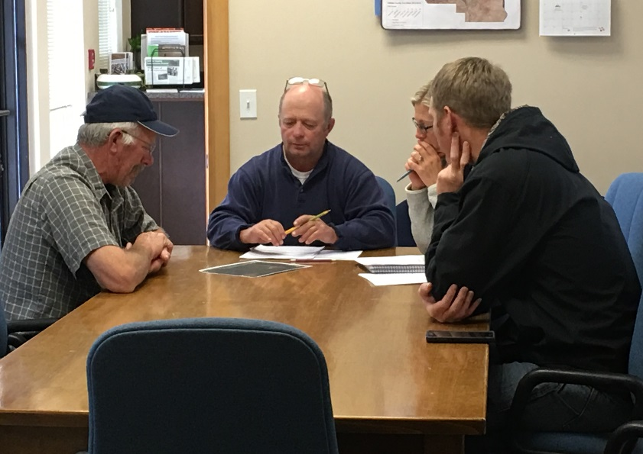
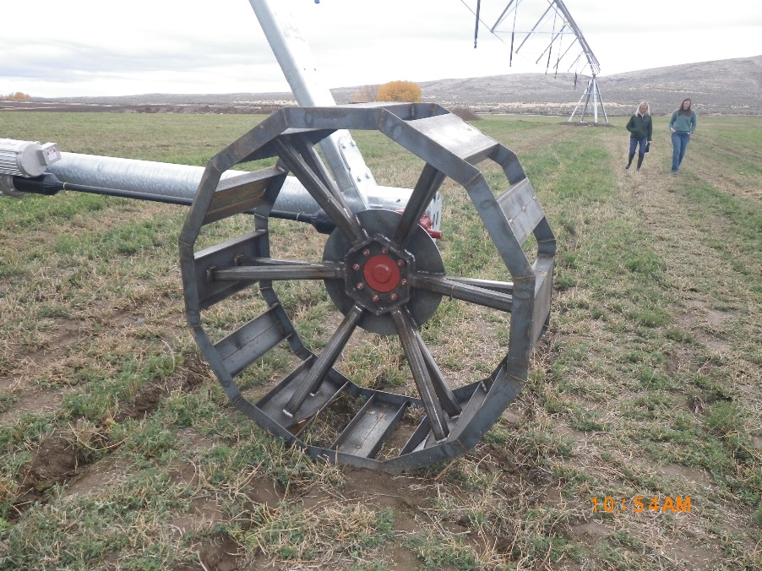
RCPP – EQIP Progress to Date
Funding Pools
Insufficient water‐drought
Livestock
Fish & wildlife habitat
EQIP Sign-up #1 Nov 2017
23 applications received
8 with no previous EQIP applications
Funding – $770,029 obligated
8 Applications 7 Contracts
3 contracts with producers with no previous EQIP contracts
All Projects Constructed and Certified

Slide 13
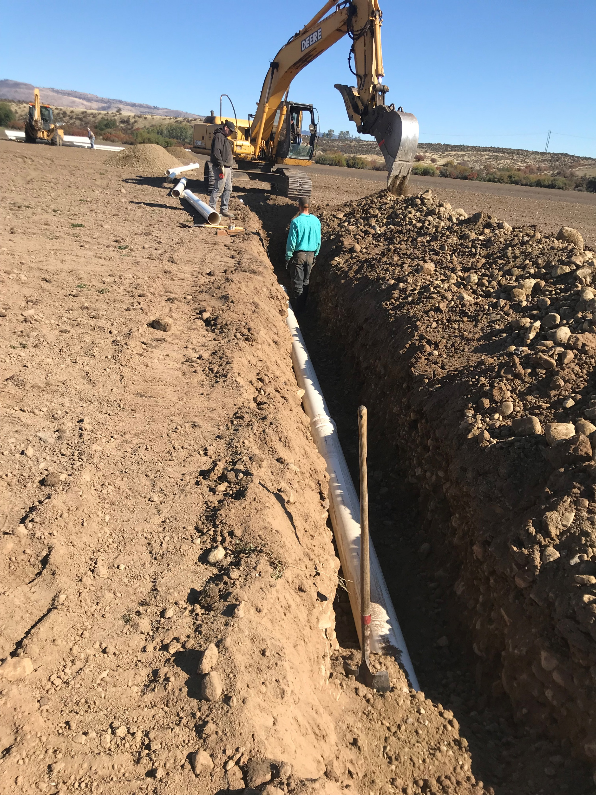
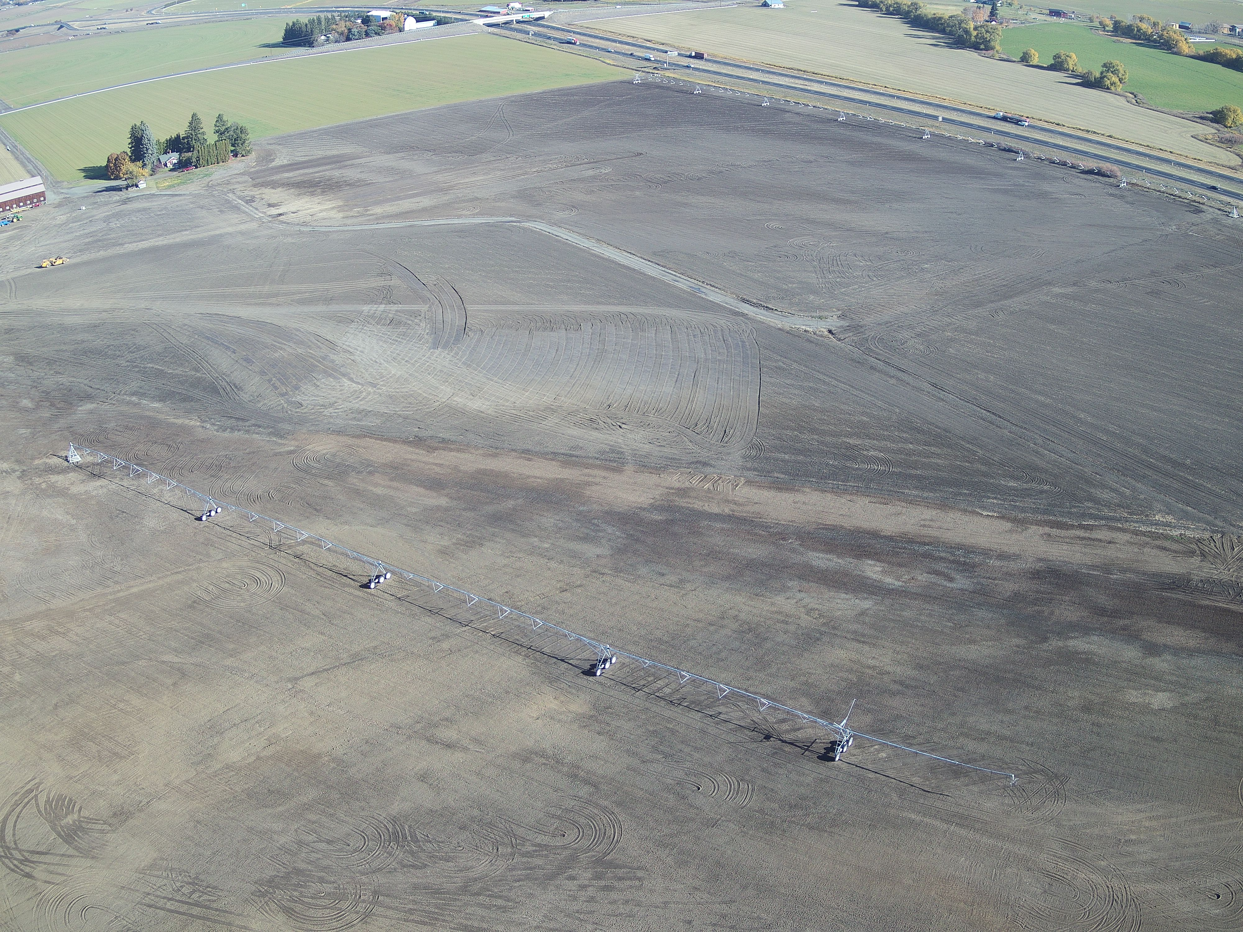
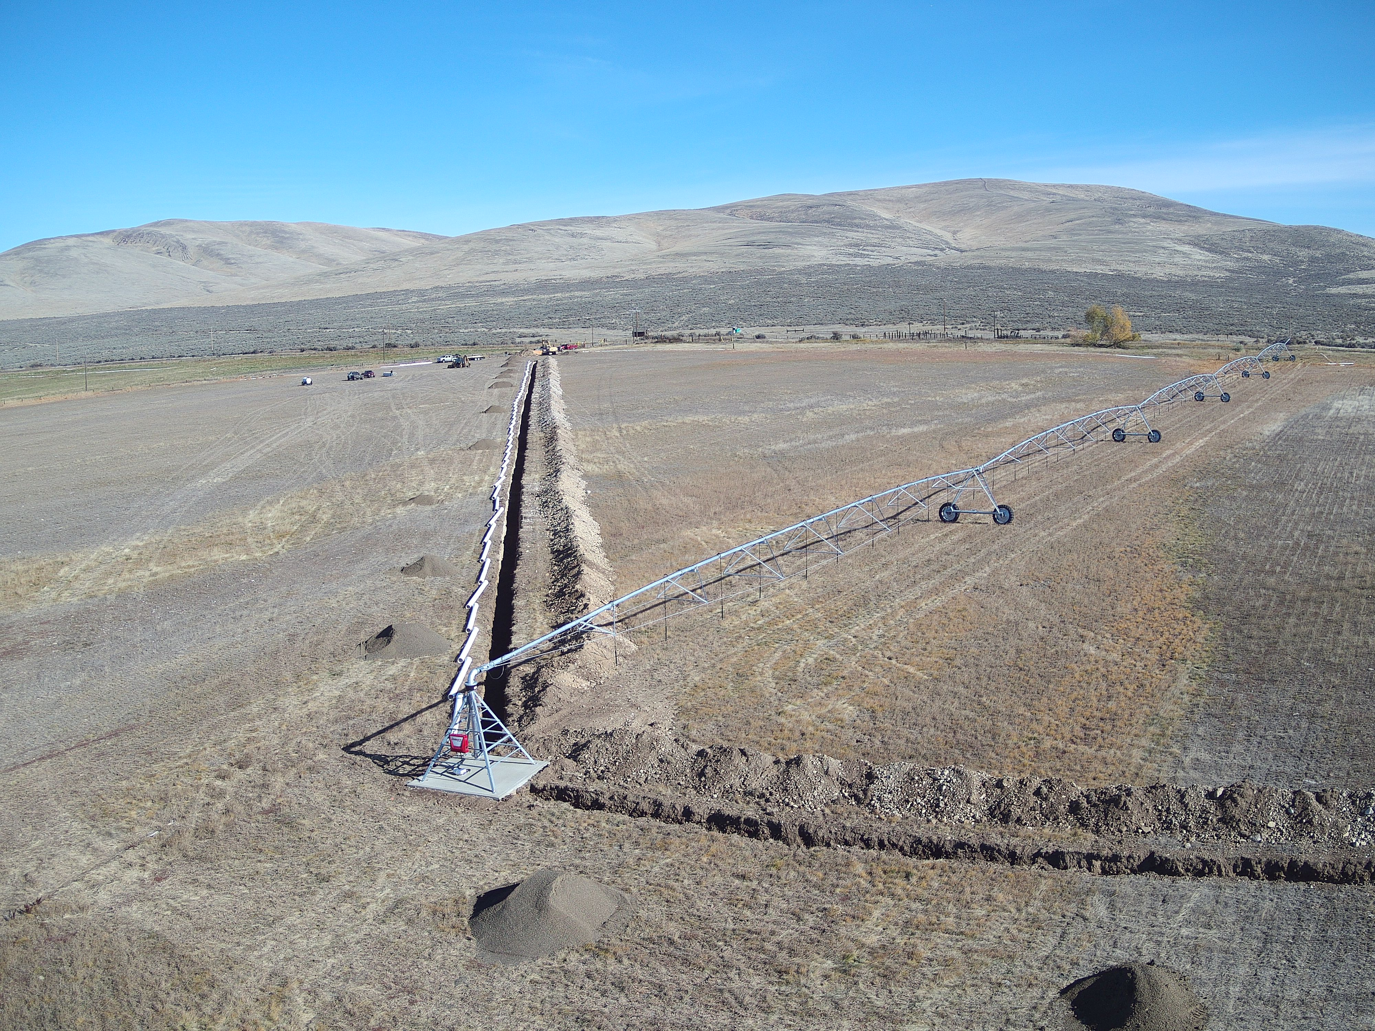
RCPP - EQIP Progress to Date
EQIP Sign-up #2 November 2018
35 applications accepted
19 applications from producers with no previous EQIP contracts
7 applications from likely Beginning Farmers
Funding – $ 935,532 obligated
8 Contracts (5 with producers with no previous EQIP)
Construction underway now on three

Slide 14
Financial Assistance
Program Updates
RCPP
New round applications due December 2019

Slide 15
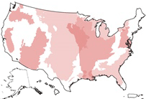
RCPP – 2019 Application Announcement
RCPP Conservation Activities
Land management/land improvement/restoration practices
Land rentals
Entity-held easements
United States-held easements
Public works/watersheds
Funding Pools
State/Multi-state
Critical Conservation Areas

Slide 16
Financial Assistance
Program Updates
RCPP
New round applications due December 2019
Fish Barrier Removal Board
Watershed Pathway
Salmon Recovery Funding Board
Targeted Investment Funds

Slide 17
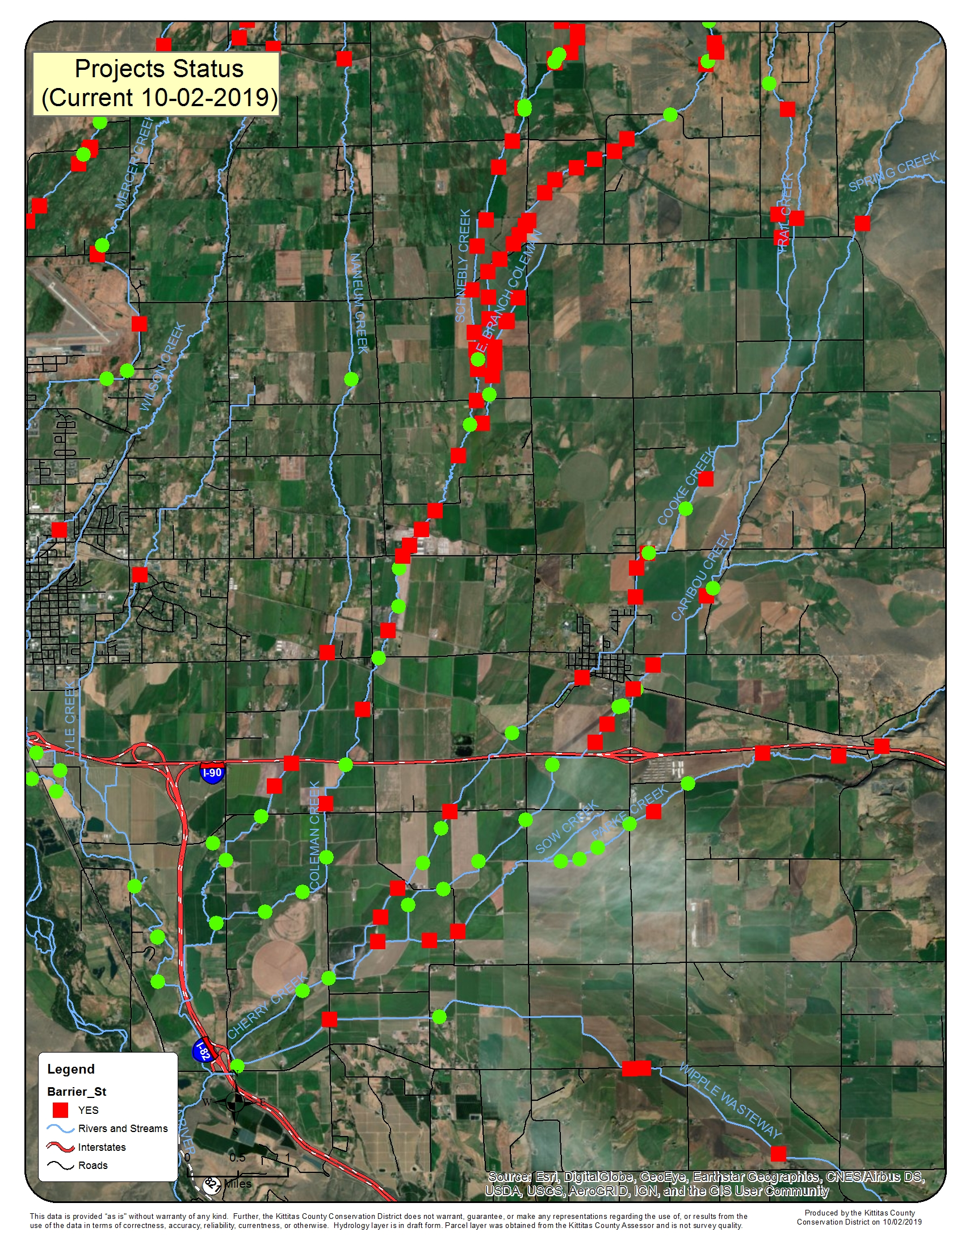
Brian Abbott Fish Barrier Removal Board
Coleman Creek – Olmstead
Cooke Creek Barriers
Parke Creek Barriers
Caribou Creek Barriers
Total - $1,723,322
Kittitas County – Vantage Hwy at Coleman Creek
Total - $1,336,080

Slide 18
Salmon Recovery Funding Board
Targeted Investment Projects - $883,000

Slide 19
Financial Assistance
Program Updates
RCPP
New round applications due December 2019
Fish Barrier Removal Board
Watershed Pathway
Salmon Recovery Funding Board
Targeted Investment Funds
Kittitas County’s Distressed Counties Sales & Use Tax Funding
Application due November 8, 2019

Slide 20
Reporting Requirements
2-Year progress report
5 Year progress report
Due November 2020

Slide 21
Action Register
Watershed Group Meeting – December 13, 2019

